Slide 1

“ARSENIC IN GROUND WATER - THE JORHAT SCENARIO”
Multi-sectoral Brain Storming Session 28-11-2014 at Iyengar Hall CSIR-NEIST Jorhat
SOME INORGANIC ADSORBENTS AS GROUND WATER PURIFICATION MEDIA TO ARREST TOXIC ANIONS LIKE ARSENATE AND FLUORIDE
By
R L Goswamee, Senior Principal Scientist
Materials Science Division CSIR-NEIST Jorhat

Slide 2
Important Parts of the Presentation
Part A – Alternative of Ground Water a Jorhat Specific (hypothetical) Calculation
Part B – Arsenic Problem in NE Region
Part C – CSIR-NEIST Initiatives – Synthetic adsorbents
Adsorbents of Bio-Origin Base from NE Region
Part D – Cost details of the Technology
Part E - Permanent Immobilisation – Toxic anions

Slide 3
First Alternative - IN JORHAT - Ground Water to be Harnessed
or
Ground Water not to be Harnessed
Some Simple Calculations on the Scope of Rain Water Use
Rainfall in Jorhat (An example from an unusually heavy rainfall
period in 2010- from Met Office Guwahati)
March 90.1mm April 282.6mm May 305.3mm. Total Rain Fall 678mm
Rainfall amount is described as the depth of water reaching the ground,
typically in inches or millimeters (25 mm equals one inch).
An inch of rain is exactly that, water that is one inch deep.
One inch of rainfall equals 4.7 gallons of water per square yard or 22,650
gallons of water per acre!

Slide 4
Assuming total rainfall as only 500 mm (or 20 inch ) rainfall in Jorhat from
April to May 2010 is equivalent to 4,53,000 Gallons ≈ 17,15,000 Liters/acre
(1 Gallon = 3.785 Liters) – No evaporation and No Percolation loss .
According to WHO per day requirement of safe water/person is 40 liters
17,15,000 Liters/acre is sufficient for 42,875 persons for one day
Assuming there is 1,000 person in NEIST Jorhat campus the rainfall in one
Acre of roof from 1st March to 31st May 2010 was sufficient for ≈ 43 days
{one Acre = 43,560 sq.ft ≈ 15.18 Assam Katha }
Water for 43 days from 90 days of rainfall over one acre of land/1000 people
There is enough POSSIBLE RAIN WATER ALTERNATIVES – YET NOT EXPLORED COMPLETELY

Slide 5
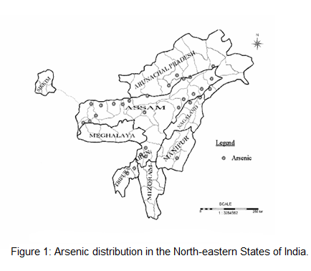
R&D Initiatives and Activities by CSIR-NEIST Jorhat on
Research Related to Problem OF ARSENIC AND FLUORIDE
In Ground Water
Background of the Problem - Arsenic occurrence in the NE States, India

Slide 6
Table - Some proven Arsenic contaminated areas of different northeastern
regions of India (as par 2004 report)
Arsenic contaminated areas of different northeastern region of India | District | Arsenic range
Assam | Barpeta, Dhemaji, Dhubari, Darrang, and Golaghat, | 100-200 ppb
Manipur | Thoubal | 799-987 ppb
Arunachal Pradesh | Papum Pare, West Kameng , East Kameng, Lower Subansiri, Dibang Valley, Tirap | 618 ppb
Tripura | West Tripura, North Tripura and Dhalai | 65-445 ppb
Nagaland | Mokok chong, Mon | 50-278 ppb

Slide 7
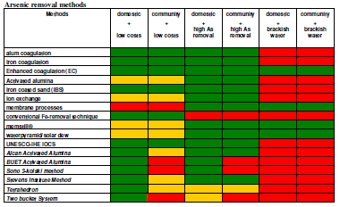
A Comparison of Globally Available Arsenic Removal Methods
Green – The method is Very Suitable; Orange – Average Suitability, Red – The method is not attractive

Slide 8
STRUCTURE OF HYDROTALCITE TYPE LDH
Mg²⁺ ion
Interlayer
Anions
Al³⁺ ion
Brucite
Hydrotalcite
8

Slide 9
Some Relevant Figures on Arsenic Removal by LDH developed by CSIR-NEIST Jorhat
A. On Performance of Different LDH Based adsorbents for arsenite
Fig - Comparative arsenite adsorption ability of different LDH
Removal Efficiency - 99.99% As from a solution of 0.1 ppm of As;
The amount of adsorbent required 0.10 g/20 ml As solution with 90 min of
exposure at (30 ± 1)°C

Slide 10
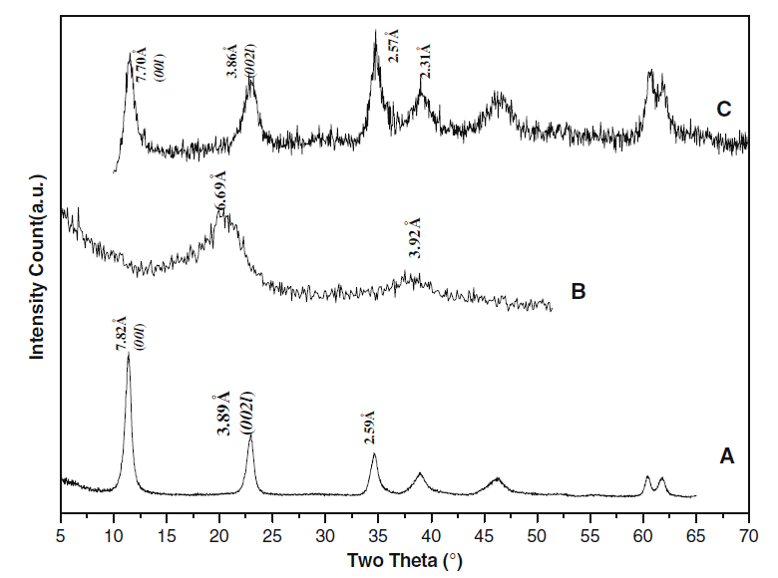
Shape Memory Effect
LDH
450ºC
Calcined LDO
H₂O
Reformed LDH

Slide 11
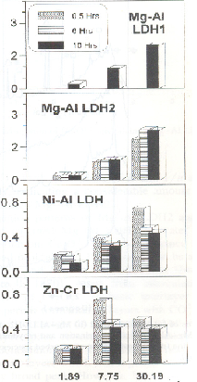
Removal of Cr⁶⁺
Removal of F⁻
Defluoridation by calcined Mg-Al-LDH
from 1mg/50ml NaF soln

Slide 12
COST ESTIMATION OF MMH PRODUCTION - Basis 100kg/batch/day
CAPITAL INVESTMENT (in Lacs) |  | COST OF PRODUCTION (in Lacs)
Land | 3.00 | Raw materials | 12.75
Building | 12.00 | Utility | 1.01
Plant & Machinery | 27.36 | Salaries & wages | 4.68
Furniture & Fixture | 3.75 | Depreciation | 3.03
Know-how & Consultancy | 4.50 | Repair & Maintenance | 2.01
Preoperative expenses | 2.25 | Rent & taxes | 0.55
Contigency | 2.50 | Interest on short term loan | 0.63
Sub-total | 55.36 | Interest on long term loan | 4.18
Margin for working capital | 0.49 | Packaging cost | 0.30
TOTAL | 55.85 | Selling expenses | 0.24
 |  | Royalities | 0.60
 |  | Total | 30.28
Cost of production per Kg Rs 100.00 (2009 Base Line Data)

Slide 13
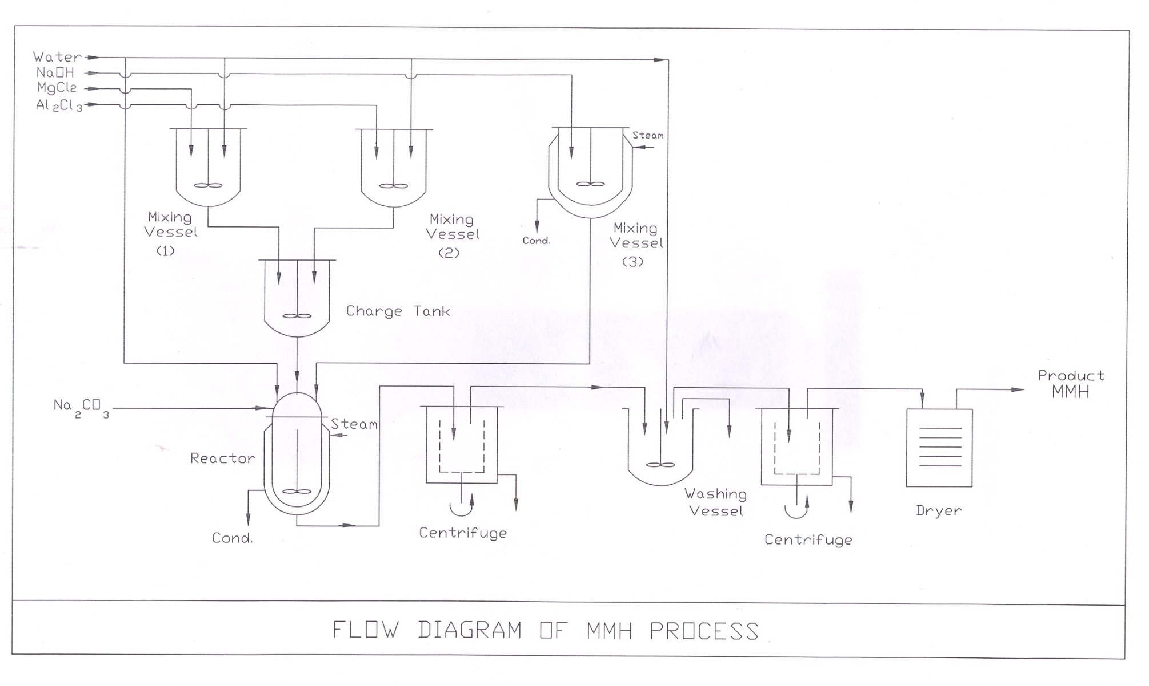
FLOW SHEET FOR PRODUCTION OF F & As REMOVING AGENT
SYNTHETIC LDH

Slide 14
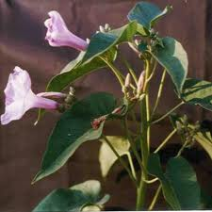
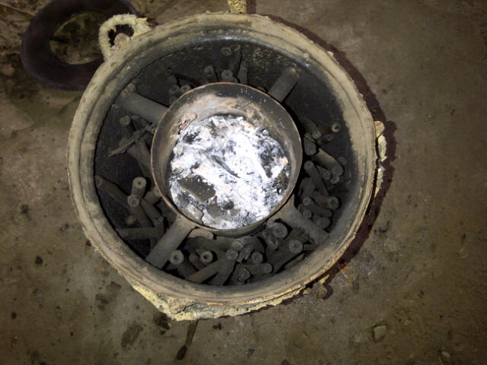
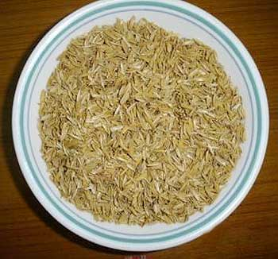
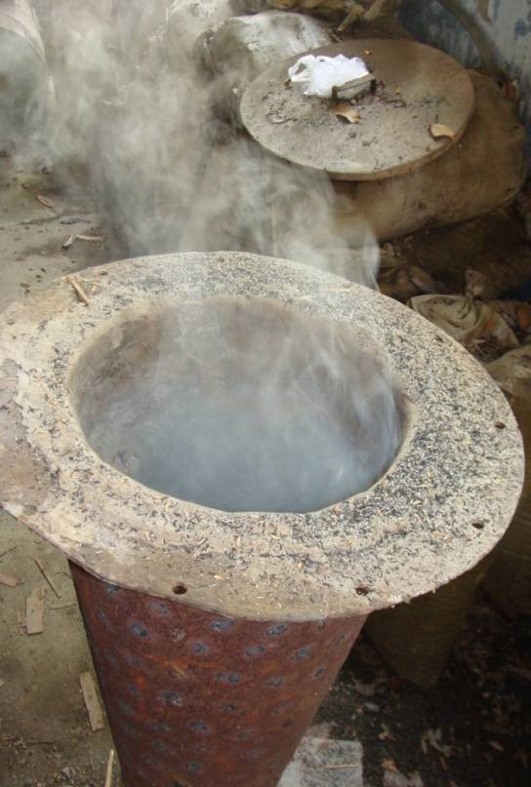
On-going works on bio-base adsorbents from local NE region resources
Green Ipomea Cornea
Inside view of carboniser
Paddy Husk
Burning in clay lined burner

Slide 15
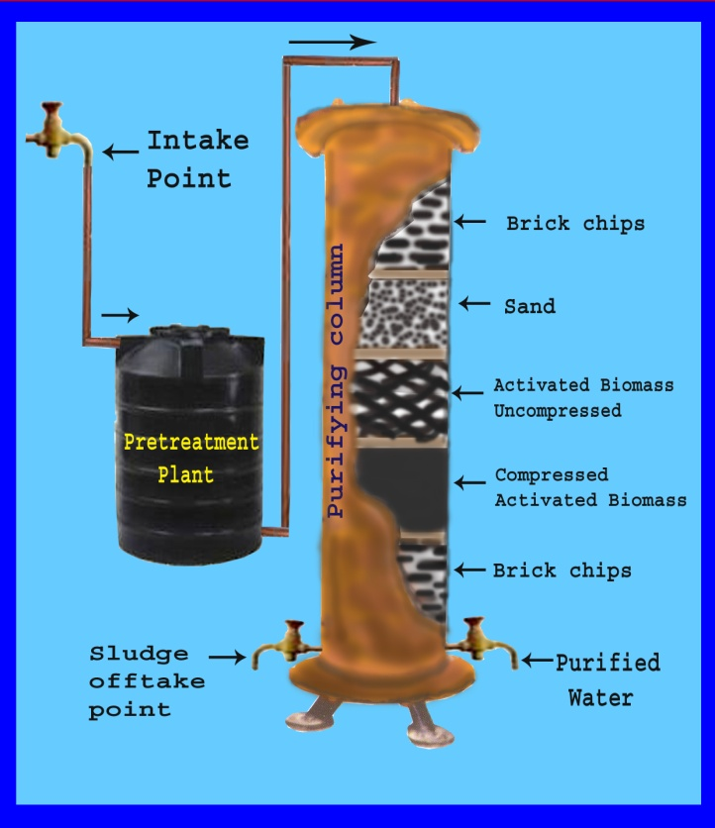
A purifier column containing filtration bed proposed to be developed using local materials (a computer drawn concept)

Slide 16
Q=720 L/day water containing c₀=10 mg/L & c_{e}=0.5 mg/L
Best fitted, Freundlich isotherm q = 7.46xC ^{0.35}
For C= 0.5 mg/L , q = 5.856mg/g
With 30 % reduction in capacity q =4.1 mg/g
Fluoride load = 6840 mg/day
Carbon requirement = 1.17 kg/day
Carbon requirement(30 % reduction) = 1.65 kg/day
Carbon requirement (due to unused bed) =1.83 kg/day
Packed Column Design
Column Study Basic Data for Future Scale Up
to Q = 720 L/day
•Column diameter = 3.4 cm
•Column depth (packed bed) = 5 cm
•Packed bed carbon density = 354 kg/m³
•V breakthrough = 320 mL
•V exhaustion = 368 mL

Slide 17
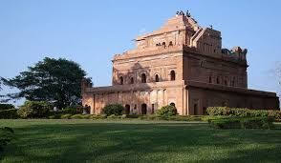
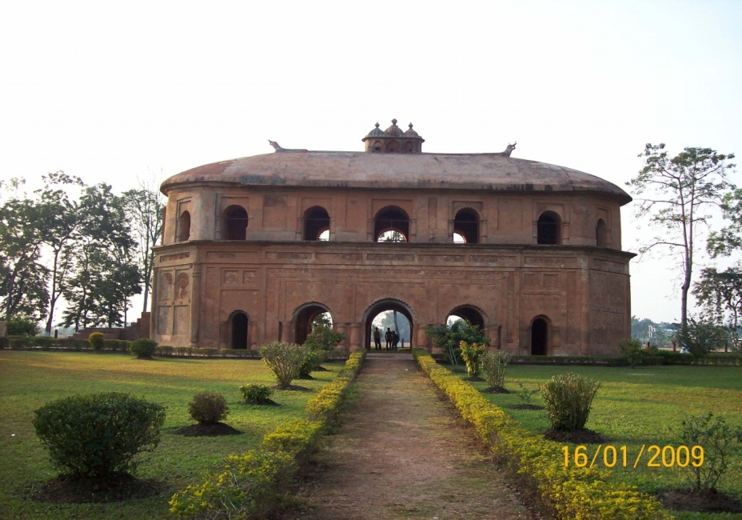
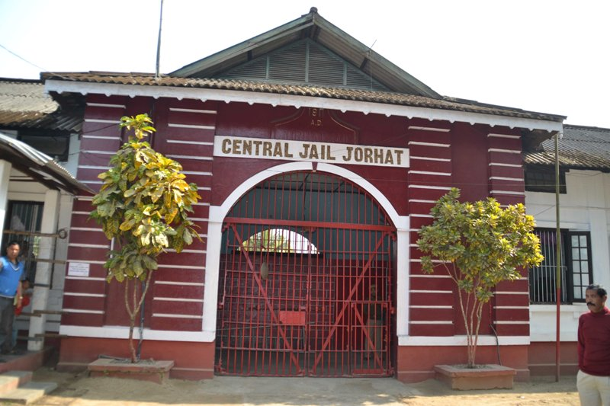
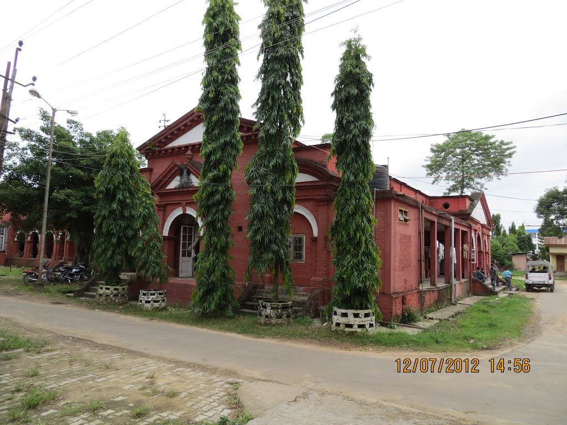
Permanent Immobilisation in Cementitious Matrix
Some old structures made with Lime-Silica cements in upper Assam still standing strong

Slide 18
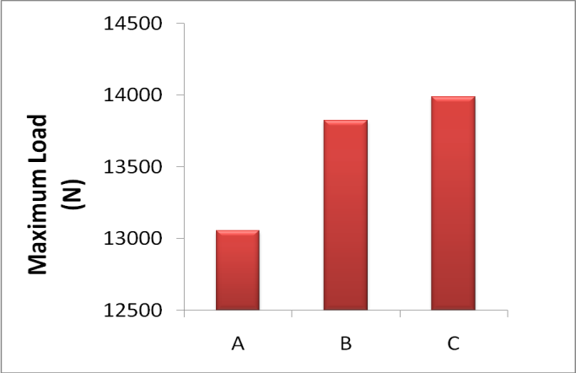
Permanent Immobilisation of Fluoride in Cementitious Matrix
Fig - Compressive strength of 21 days cube of hydrated products, where,
A=Basic adsorbent (BA) , B=BA+ Cemical Activating Agent (CA),
C=BA+ CA + fluoride

Slide 19

Courtesy – Garden section NEIST JORHAT
THANK YOU

